Slide 1
Testing with Behat And Mink
Presenter: Miss Mansee Jadhav
Masters - Computer Science

Slide 2
Introduction to Automated testing
Automated testing tools are capable of executing tests, reporting outcomes and comparing results with earlier test runs.
Tests can be run repeatedly.
You can take a look at your code, alter it, and continue to run tests until the actual and expected outcomes align.
Notes:
Automated testing tools are capable of executing tests, reporting outcomes and comparing results with earlier test runs.Tests carried out with these tools can be run repeatedly, at any time of day. The method or process being used to implementautomation is called a test automation framework.

Slide 3
Automated testing Versus Manual testing
Advantages:
1. Runs tests quickly and effectively.
2. Can be cost effective.
3. More interesting.
4. Everyone can see results.

Slide 4
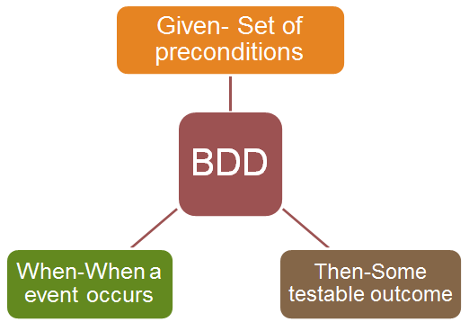
Behavior Driven testing : Requirements
A good BBD test script should meet following requirements :
Define characteristics for the feature.
Prioritize features.
Describe them with readable scenarios.
Then Implement them.

Slide 5
Automated testing with Behat and Cucumber
Behat is an open source Behavior Driven Development framework for PHP.
Cucumber is for Ruby and other web applications.
Both Cucumber and Behat support:
Documentation availability
Flexibility in passing parameters
Steps, scenario and feature scoping
Hooks and pre-conditions
Binding to code
Formatting flexibility

Slide 6

Which one to choose????

Slide 7
Behat IT IS...
It is easily portable and very efficient compared to Cucumber.
Cucumber is outdated now.
GHERKIN is a structured language to define feature in Behat.
MINK: It is a standalone library to use PP to command a "browser". One easy API that can be used to command Selenium server etc.
Drupal 7 supports plugin for Behat.
Drupal 8 Behat is in core.

Slide 8

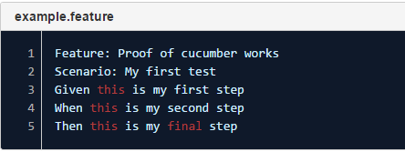
Defining .Feature File
GIVEN- defines the original state of the system.
WHEN- defines the actual action that user takes.
THEN- defines the observable system state after the action is performed.

Slide 9
Defining FeatureContext.php File
BEHAT: It maps every step in feature file to PHP Callback.
Behat executes each step in your scenario by calling the functions associated with it.
A FeatureContext.php file that holds the PHP callbacks for each step

Slide 10
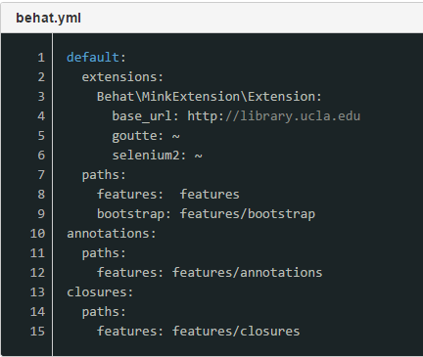

Defining config file(.yml)

Slide 11
Installing Behat , Mink and Selenium server
PHP
Download XAMPP for Windows or MAMP for Mac or use your preferred method.
XAMPP
COMPOSER: Dependency Manager for PHP. It is a tool for dependency management in PHP. It allows you to declare the libraries your project depends on and it will manage (install/update) them for you.
For Windows:
Download link https://getcomposer.org/Composer-Setup.exe
Run the executable specifying "C:\xampp\php\php.exe" for "Where is PHP.exe located".
For Mac:
Go to: http://www.abeautifulsite.net/installing-composer-on-os-x/ and follow the on-screen instructions.
You may already have composer installed, to check run the command 'Composer' from the Terminal.
Notes:
Dependency management#
Composer is not a package manager in the same sense as Yum or Apt are. Yes, it deals with "packages" or libraries, but it manages them on a per-project basis, installing them in a directory (e.g. vendor) inside your project. By default it does not install anything globally. Thus, it is a dependency manager. It does however support a "global" project for convenience via the global command.
This idea is not new and Composer is strongly inspired by node's npm and ruby's bundler.
Suppose:
You have a project that depends on a number of libraries.
Some of those libraries depend on other libraries.
Composer:
Enables you to declare the libraries you depend on.
Finds out which versions of which packages can and need to be installed, and installs them (meaning it downloads them into your project).
See the Basic usage chapter for more details on declaring dependencies.

Slide 12

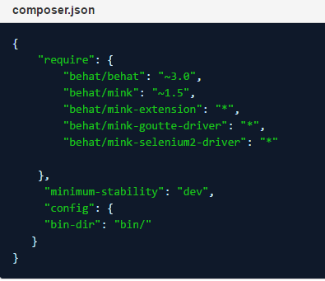
What to write where???
Create a directory at C:\Behat on your local machine (or whatever directory structure you prefer).
In the Behat folder, create a file called "composer.json" and add the following into it:
composer.json

Slide 13
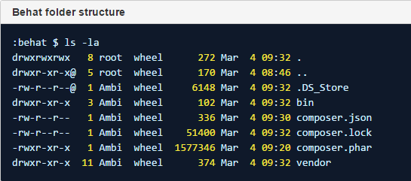
What to write where???
Install composer and Behat in newly created folder Behat by typing composer install under ~/Behat directory in command prompt.
This will create a 'vendor' folder in your behat folder.

Slide 14


What to write where???
Add the Behat path "C:\Behat\bin" => YOUR BEHAT DIR to your system path variable.
Make Behat Global
Create a global symlink to access behat from anywhere by setting a sym link: ("/opt/behat/" = YOUR BEHAT DIR)
Test that Behat has installed correctly

Slide 15
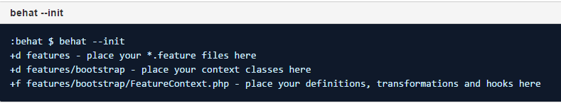
behat --init Command
This will create:
- a features folder,
- a bootstrap folder inside the features folder and
- the FeatureContext.php file inside the bootstrap folder.

Slide 16
Installing Behat , Mink and Selenium server- Complete Documentation..
https://docs.library.ucla.edu/pages/viewpage.action?spaceKey=~mansee8&title=How+to+install+behat+and+mink

Slide 17
Installing selenium server
Required for running Remote Selenium WebDriver.
Making use of the latest and greatest features of the WebDriver InternetExplorerDriver.
install selenium standalone server from http://www.seleniumhq.org/download/
Point to remember: Kindly download Selenium server compatible with PHP. The one we downloaded is PHP by Lukasz Kolczynski.

Slide 18

Installing selenium server..continued
Now open a new Command prompt and set path= Path where your JAVA compiler and JAVA jre is located.
For example on my computer the path where JAVA files are located is "C:\Program Files\Java\jre1.8.0_60\bin";
So the command in command prompt will be set path= "C:\Program Files\Java\jre1.8.0_60\bin";
Start the selenium server using:

Slide 19
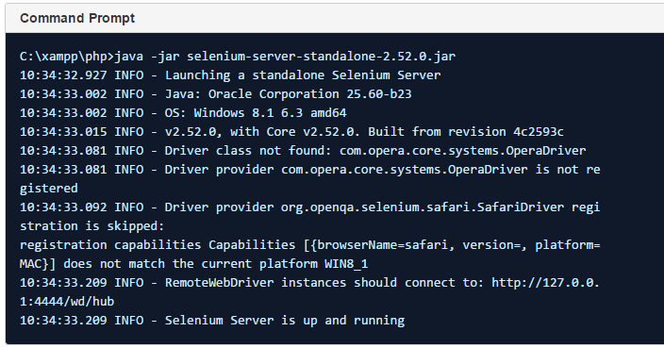
Selenium server Running!!!

Slide 20


Slide 21
Examples - Behat testing with Selenium
Test.feature file which check the search functionality by populating the main search box of library site.
Steps that this test performs are:
1. It opens the browser.
2. Navigates to Library.ucla.edu site.
3. Populates the site search field with books.
4.Searches the site for books.

Slide 22
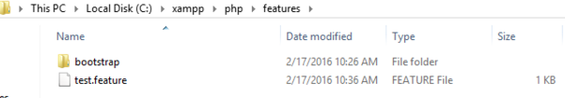
Placement of this test.feature file

Slide 23
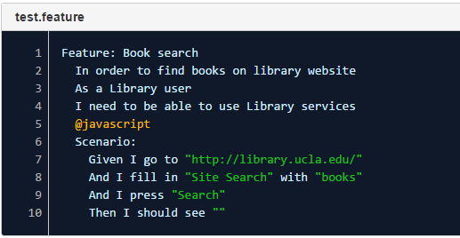
Test.feature file
@javascript is mandatory for features file to coordinate with selenium and open up the browser and test functionality.

Slide 24
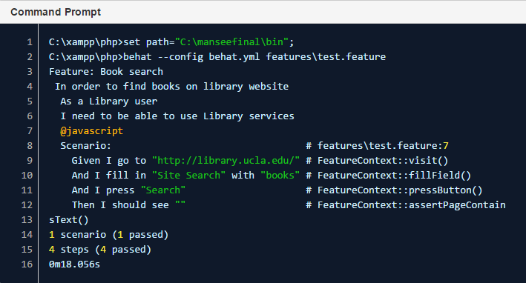

Running your test

Slide 25
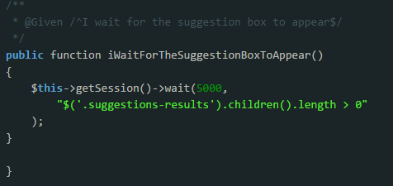

Making changes to FeatureContext.php
Feature: I wait for suggestion box to appear

Slide 26

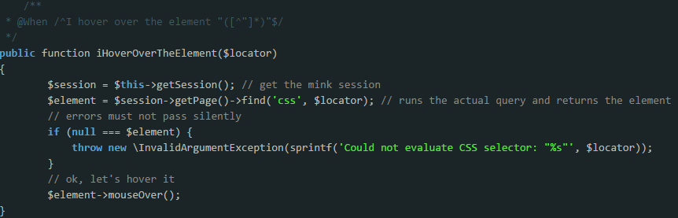
Making changes to FeatureContext.php
Feature: I hover over the element

Slide 27
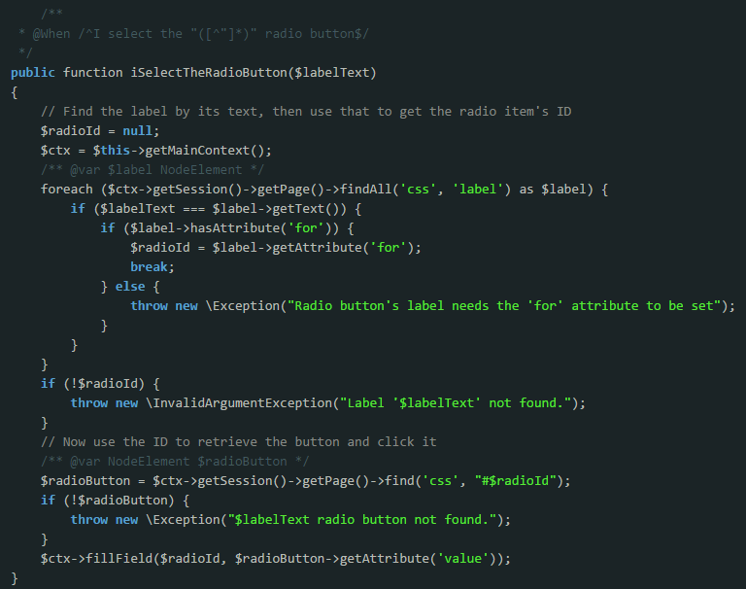
Feature: I select
The radio button..

Slide 28
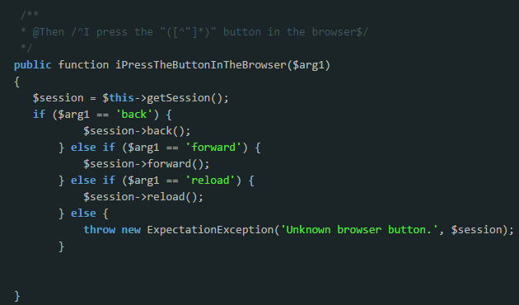

Making changes to FeatureContext.php
Feature: I press back/forward/reload button in the browser

Slide 29

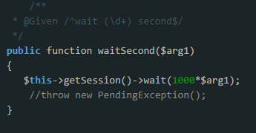
Making changes to FeatureContext.php
Feature: Wait * seconds

Slide 30


Slide 31
Limitations and future Work
Getting it to work with Drupal and Behat plugin and Travis.
Performance issues
Finding people to write user stories.
Future Scope:

Slide 32


Slide 33
Questions?????

